Slide 1
Numbered List of Niche and Adaptations: Describe 3 environmental conditions and the unique adaptations that evolved within the species to overcome each aspect of the environment.
Classification
Domain
Kingdom
Phylum
Class
Order
Family
Genus
Species
Common Name
Scientific Name
Name of Ecosystem
By:
Animal Motto:

Slide 2
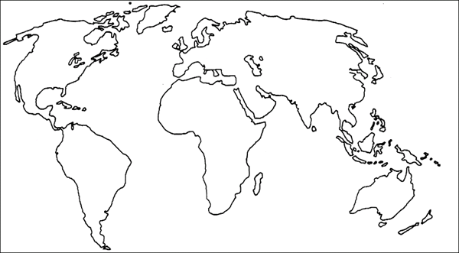
Ecosystem packet
Draw either the Carbon Cycle or the Nitrogen Cycle. Both cycles have been overwhelmed by inputs from our modern society. Highlight the manmade overload in the cycle and list the natural consequences.
Heterotrophs (1 mammal max.) & Photoautotrophs
.
.
.
General ecosystem name, colored in all the world
Specific location, colored on top of general ecosystem color
Your name:
Ecosystem name:

