Slide 1
Blood Pressure
Basics

Slide 2
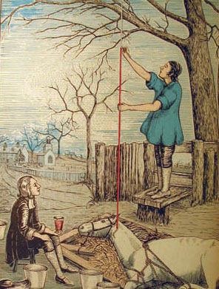
History of Blood Presure
Stephen Hales an English clergyman was the first person to measure blood pressure. He was relentless in his pursuit of understanding the mysteries of life and always seemed to be experimenting and inventing things. In December (1710?) I caused a mare to be tied down alive on her back; she was 14 hands high, and about 14 years of age, had a fistula on her withers, was neither very lean nor very lusty: having laid open the left crural artery about 3 inches from her belly, I inserted into it a brass pipe whose bore was 1/6 of an inch in diameter; and to that, by means of another brass pipe which was fitly adapted to it, I fixed a glass tube, of neary the same diameter, which was 9 feet in length; then untying the ligature on the artery, the blood rose in the tube 8 feet 3 inches perpendicular above the level of the left ventricle of the heart: but it did not attain to its full height at once; . . when it was at its full height, it would rise and fall at and after each pulse 2,3, or 4 inches. . .” (Hales,1738; 1).

Slide 3
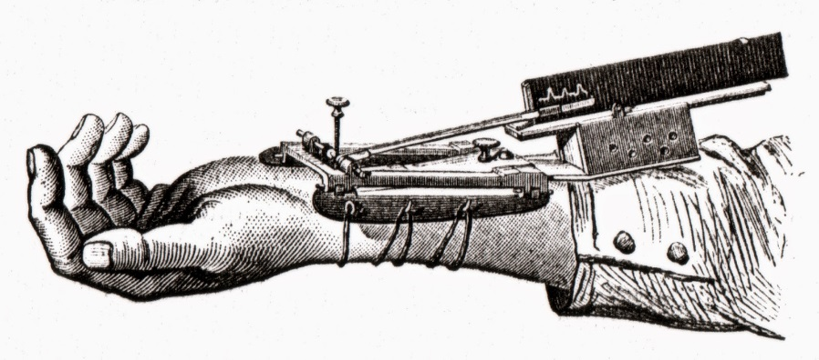
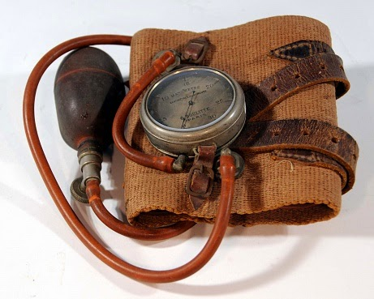
History Continued
It took nearly 150 years before an instrument was invented that could measure blood pressure without breaking the skin. Ritter von Basch’s sphygmomanometer was the first to inspire other similar devices that finally led to our present day method perfected by Riva-Rocci in 1896.

Slide 4
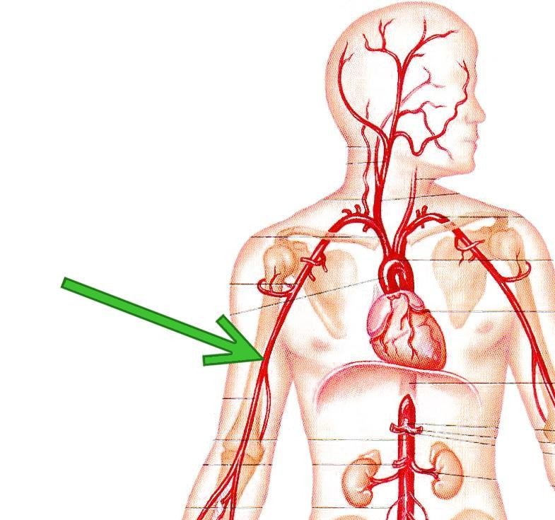
History Cont.
1905 N C Korotkoff reported that tapping sounds could be heard when a stethoscope was placed over the brachial artery at the cubital fossa distal to the Riva-Rocci cuff. These sounds were caused by the blood flowing back into the artery as the pressure of the cuff is released.
The brachial artery is used because it is close to the heart and has no major arteries branching off from it at the point shown by the green arrow.

Slide 5
Karotkoff Sounds
The cuff cuts off the flow of blood distal to the Riva-Rocci pressure cuff. At the time your blood pressure is strong enough to overcome the pressure of the cuff, you hear your first sound. This is the systolic pressure or highest pressure exerted onto your arteries when the left ventricle contracts.
Origin - Systole
late 16th century: via late Latin from Greek sustolē, from sustellein ‘to contract.’

Slide 6
Karotkoff Sounds
When the tapping of the arterial walls can no longer be heard the blood is freely flowing past the blood pressure cuff. This is the lowest amount of pressure exerted on your arterial walls and this occurs when the heart is at rest (not contracting). This is your diastolic or minimum pressure reading.
Orgin - Diastole
late 16th century: via late Latin from Greek, ‘separation, expansion,’ from diastellein, from dia ‘apart’ + stellein ‘to place.’

Slide 7
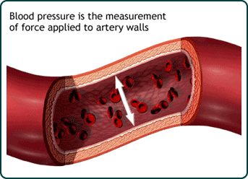
What is blood pressure?
The pressure that your blood exerts against your arteries as it is pumped through your body by the heart
The pressure in the arteries increases when the heart beats and decreases while it is resting
http://www.cdc.gov/bloodpressure/about.htm

Slide 8
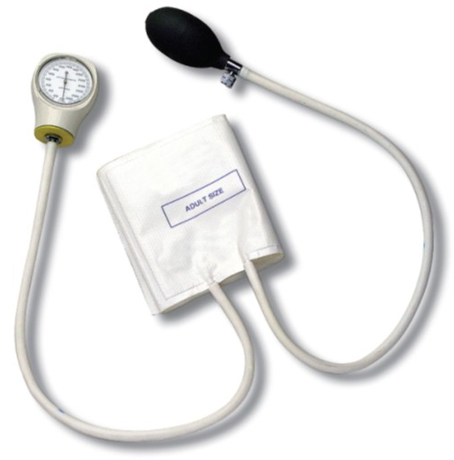
Measuring Blood Pressure
The Sphygmomanometer
The Sphygmomanometer is also
called a Blood Pressure Cuff
Pump
Inflates the cuff to stop blood flow
Dial
Used to read
blood pressure
Valve
Lets air out of the cuff, allowing it to deflate
Cuff
Used to temporarily stop blood flow
http://upload.wikimedia.org/wikipedia/commons/b/b9/CM-106.jpg

Slide 9
Syphygmomanometer
Sphygm - From the Ancient Greek σφυγμός (sphugmós, “pulse”), from σφύζω (sphúzō, “I beat”, “I throb”).
Manometer – an instrument used to measure pressure in a fluid. From French manomètre, formed from Ancient Greek μανός (manós, “thin, rare”) + μέτρον (métron)

Slide 10

Measuring Blood Pressure
The Stethoscope
A stethoscope allows you to hear your heart beat and your blood flow
When used with a sphygmomanometer, you can hear the blood flow through
your brachial artery, allowing you
to measure your blood pressure
http://wakemedvoices.org/wp-content/uploads/2011/09/stethoscope.jpg

Slide 11
History of Stethoscope
1800’s
Invented by Rene Laennec when he discovered that he could hear the heart of a patient through a tube of paper he rolled up so he did not have to place his head on the patient (he was tired of placing the side of his face against dirty, smelly, lice ridden bodies.)
Stethos – Greek for chest
Scopos – Greek for examination

Slide 12
Why listen to the body?
Auscultation
“Whoosh” – a heart valve isn’t fully closing
No sound in your abdomen – obstructed bowel
  Abdominal sounds (bowel sounds) are made by the movement of the intestines as they push food through. The intestines are hollow, so bowel sounds echo through the abdomen much like the sounds heard from water pipes.
Doctors listen to three main organs during auscultation: the heart, the lungs, and the gastrointestinal system. They listen for unusual heart sounds such as gallops or murmurs, unusual lung sounds such as wheezes and crackles and the presence of bowel sounds.

Slide 13
Auscultation of the Liver
The Liver scratch test can be used to determine the size and location of the liver during auscultation of a paitient
Place the stethoscope over the approximate location of the patient’s liver and then scratch the skin of the paitient’s abdomen lightly, moving laterally along the liver border. When the liver is encountered the scratching sound heard in the stethoscope will increase significantly.

Slide 14
You are the Doctor
Listen to the links below and then use a stethoscope to listen to yourself and any volunteers.
Lung Sounds – Go to the site below and click on Begin Course http://www.easyauscultation.com/course-contents?courseid=201
Heart Sounds – Go to the site below and click on Begin Course -http://www.easyauscultation.com/course-contents?courseid=22

Slide 15
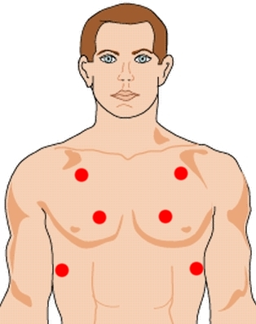
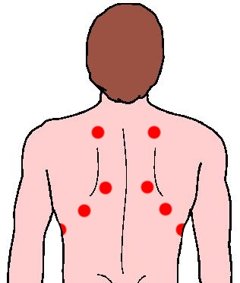
Where to auscultate for lung sounds

Slide 16
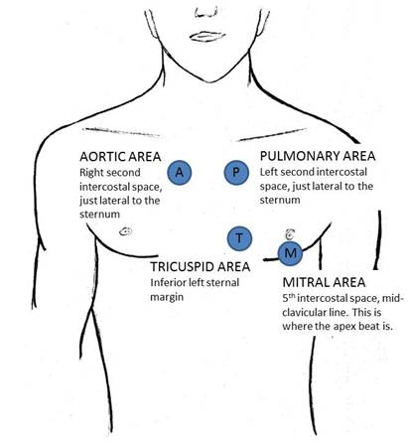
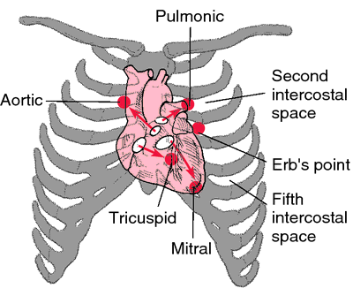
Auscultation of the heart (you are listening to the valves open and close)

Slide 17
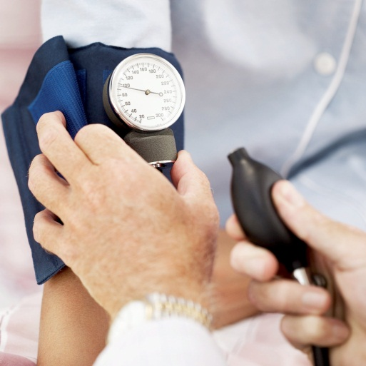
Measuring Blood Pressure
Procedure
Sit comfortably with arm supported at heart level
Snugly wrap the sphygmomanometer cuff around
the upper arm, one inch above the elbow
Place the stethoscope just above the crease of the
elbow
Pump the cuff to around 120-130 mmHg
While listening with the stethoscope, slowly open
the valve to let the pressure fall
  When you first hear the beat of the blood flow, that is the systolic pressure
  When you last hear the beat of the blood flow, that is the diastolic pressure

Slide 18

Reading Blood Pressure
Blood pressure is measured in mmHg,
and given as a fraction
$$\frac{120}{80}$$
Systolic Pressure
Pressure in the arteries while the heart beats
Diastolic Pressure
Pressure in the arteries while the heart rests

Slide 19
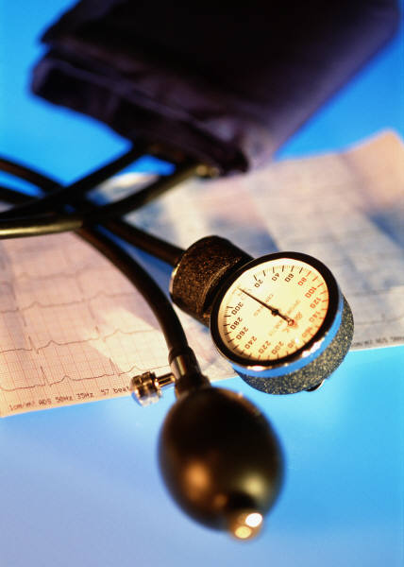
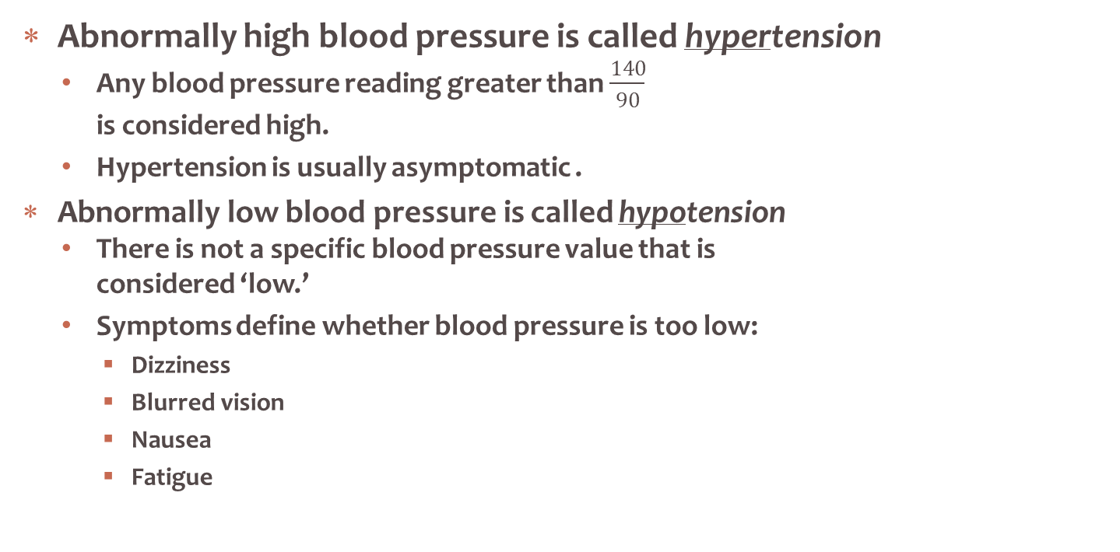
Variations in Blood Pressure
Abnormally high blood pressure is called hypertension
  Any blood pressure reading greater than $\frac{140}{90}$
  is considered high.
  Hypertension is usually asymptomatic .
Abnormally low blood pressure is called hypotension
  There is not a specific blood pressure value that is
  considered ‘low.’
  Symptoms define whether blood pressure is too low:
    Dizziness
    Blurred vision
    Nausea
    Fatigue

Slide 20
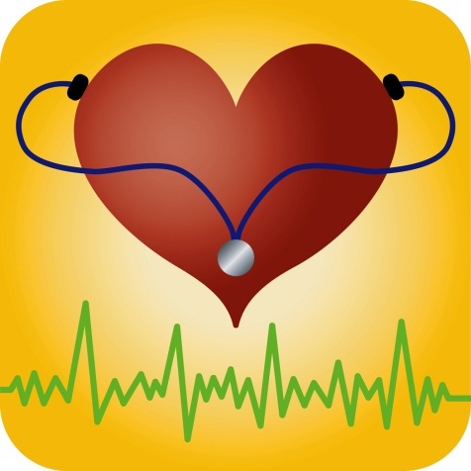
Hypertension
Caused by both hereditary and behavioral factors
  Diabetes
  High-sodium diets
  Smoking
  Age
  Genetic factors
There are usually no symptoms of high blood
pressure, but the consequences of
untreated hypertension can be severe:
  Heart disease
  Heart failure
  Kidney failure
  General heart/artery damage

Slide 21
Blood Pressure Diagnostic Chart for hypertension
Blood Pressure Category | Systolic mm Hg (upper #) |  | Diastolic mm Hg (lower #)
Normal | less than 120 | and | less than 80
Prehypertension | 120 – 139 | or | 80 – 89
High Blood Pressure (Hypertension) Stage 1 | 140 – 159 | or | 90 – 99
High Blood Pressure (Hypertension) Stage 2 | 160 or higher | or | 100 or higher
Hypertensive Crisis (Emergency care needed) | Higher than 180 | or | Higher than 110

Slide 22
Hypertensive Crisis can present as Hypertensive Urgency or Hypertensive Emergency

Slide 23
Hypertensive Urgency
Hypertensive urgency is a situation where the blood pressure is severely elevated [180 or higher for your systolic pressure (top number) or 110 or higher for your diastolic pressure (bottom number)], but there is no associated organ damage. Those experiencing hypertensive urgency may or may not experience one or more of these symptoms:
Severe headache
Shortness of breath
Nosebleeds
Severe anxiety
Treatment of hypertensive urgency generally requires readjustment and/or additional dosing of oral medications, but most often does not necessitate hospitalization for rapid blood pressure reduction. A blood pressure reading of 180/110 or greater requires immediate evaluation, because early evaluation of organ function and blood pressure elevations at these levels is critical to determine the appropriate management.

Slide 24
Hypertensive Emergency
Hypertensive Emergency
A hypertensive emergency exists when blood pressure reaches levels that are damaging organs. Hypertensive emergencies generally occur at blood pressure levels exceeding 180 systolic OR 120 diastolic, but can occur at even lower levels in patients whose blood pressure had not been previously high.
The consequences of uncontrolled blood pressure in this range can be severe and include
Stroke
Loss of consciousness
Memory loss
Heart attack
Damage to the eyes and kidneys
Loss of kidney function
Aortic dissection
Angina (unstable chest pain)
Pulmonary edema (fluid backup in the lungs)
Eclampsia
If you get a blood pressure reading of 180 or higher on top or 110 or higher on the bottom, and are having any symptoms of possible organ damage (chest pain, shortness of breath, back pain, numbness/weakness, change in vision, difficulty speaking) do not wait to see if your pressure comes down on its own. Seek emergency medical assistance immediately. Call 9-1-1. If you can't access the emergency medical services (EMS), have someone drive you to the hospital immediately.

Slide 25
Hypotension – Low Blood Pressure
As long as you are not experiencing symptoms of low blood pressure, there is no need for concern. Most doctors consider chronically low blood pressure dangerous only if it causes noticeable signs and symptoms, such as:
Dizziness or lightheadedness
Fainting (called syncope)
Dehydration and unusual thirst
Dehydration can sometimes cause blood pressure to drop. However, dehydration does not automatically signal low blood pressure. Fever, vomiting, severe diarrhea, overuse of diuretics and strenuous exercise can all lead to dehydration, a potentially serious condition in which your body loses more water than you take in. Even mild dehydration (a loss of as little as 1 percent to 2 percent of body weight), can cause weakness, dizziness and fatigue.
Lack of concentration
Blurred vision
Nausea
Cold, clammy, pale skin
Rapid, shallow breathing
Fatigue
Depression
As long as no symptoms are present, low blood pressure is not a problem. However, if your blood pressure is normally higher or if you are experiencing any of the symptoms listed above, your low pressure may have an underlying cause.

Slide 26
Possible Causes of Hypotension
Prolonged bed rest
Pregnancy
During the first 24 weeks of pregnancy, it's common for blood pressure to drop.
Decreases in blood volume
A decrease in blood volume can also cause blood pressure to drop. A significant loss of blood from major trauma, dehydration or severe internal bleeding reduces blood volume, leading to a severe drop in blood pressure.
Certain medications
A number of drugs can cause low blood pressure, including diuretics and other drugs that treat hypertension; heart medications such as beta blockers; drugs for Parkinson's disease; tricyclic antidepressants; erectile dysfunction drugs, particularly in combination with nitroglycerine; narcotics and alcohol. Other prescription and over-the-counter drugs may cause low blood pressure when taken in combination with HBP medications.
Heart problems
Among the heart conditions that can lead to low blood pressure are an abnormally low heart rate (bradycardia), problems with heart valves, heart attack and heart failure. Your heart may not be able to circulate enough blood to meet your body's needs.

Slide 27
Causes of Hypotension
Endocrine problems
Such problems include complications with hormone-producing glands in the body's endocrine systems; specifically, an under-active thyroid (hypothyroidism), parathyroid disease, adrenal insufficiency (Addison's disease), low blood sugar and, in some cases, diabetes.
Severe infection (septic shock)
Septic shock can occur when bacteria leave the original site of an infection (most often in the lungs, abdomen or urinary tract) and enter the bloodstream. The bacteria then produce toxins that affect blood vessels, leading to a profound and life-threatening decline in blood pressure.
Allergic reaction (anaphylaxis)
Anaphylactic shock is a sometimes-fatal allergic reaction that can occur in people who are highly sensitive to drugs such as penicillin, to certain foods such as peanuts, or to bee or wasp stings. This type of shock is characterized by breathing problems, hives, itching, a swollen throat and a sudden, dramatic fall in blood pressure.
Neurally mediated hypotension
Unlike orthostatic hypotension, this disorder causes blood pressure to drop after standing for long periods, leading to symptoms such as dizziness, nausea and fainting. This condition primarily affects young people and occurs because of a miscommunication between the heart and the brain.
Nutritional deficiencies
A lack of the essential vitamins B-12 and folic acid can cause anemia, which in turn can lead to low blood pressure.

